Slide 1

Big Data in Healthcare: Acquisition, Management, and Visualization Using System Dynamics
Ashiat Ashake Adeogun & Misagh Faezipour
College of Basic and Applied Sciences, Healthcare Informatics & Department of Engineering Technology, Middle Tennessee State University, Murfreesboro, Tn, United States.
Email:aaa2ev@mtmail.mtsu.edu, misagh.faezipour@mtsu.edu
The 2023 International Conference on Computational Science and Computational Intelligence (CSCI'23)
Systems
Engineering Lab (SEL)

Slide 2

Outline
Introduction Big Data in Healthcare
Background & Literature Healthcare as a Big-data Repository
Methodology System Dynamics Modeling
Proposed Solution The Causal Model for Big Data in Healthcare
Conclusion Discussion and Summary
Systems
Engineering Lab (SEL)

Slide 3
Big Data in Healthcare
Big data is a term used to describe enormous volumes of data that are larger than what typical software or internet-based platforms can manage, store, process, and analyse efficiently.
Big data refers to the size and complexity of massive data collections. which call for specialist management and insight extraction techniques
Systems
Engineering Lab (SEL)

Slide 4
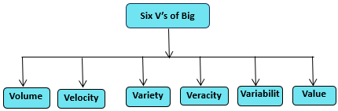

Big Data in Healthcare(Contd)
Big data in healthcare is defined by volume, variety, velocity, veracity, variability, and value. These characteristics illustrate the complexities and potential of healthcare data for improved outcomes and innovation.
Big data analytics enables organizations to uncover patterns and trends, informing decision-making and driving innovation across various sectors, including healthcare.
The Visualization Six V’s of Big Data

Slide 5

Six V’s of Big Data
Volume refers to the vast amount of data beyond traditional database capabilities and requiring specialized solutions for storage and processing.
Velocity: concerns the speed of data collection for real-time analysis.
Variety encompasses diverse data types.
Veracity: highlights data quality and reliability.
Variability addresses changes and complexity in healthcare data.
Value: Involves deriving insights for better decision-making and business outcomes.

Slide 6
Healthcare as a Big-data Repository
The integration of electronic health records (EHRs) and health information systems (HISs) has revolutionized the healthcare system.
EHRs digitalize patient medical records, facilitating easy access and sharing of data among healthcare providers.
The adoption of EHRs and HISs has altered healthcare, resulting in a robust data repository that improves decision-making, provider collaboration, research, and public health efforts through intensive data analysis.
HISs extend beyond EHRs by managing, analyzing, and seamlessly integrating data from diverse sources, thus harnessing the potential of big data analytics to derive valuable insights within the healthcare sector.
Systems
Engineering Lab (SEL)

Slide 7
Healthcare as a Big-data Repository(Contd)
Ensuring data privacy, security, and ethical use is crucial, with a focus on maintaining patient confidentiality and adhering to regulations such as HIPAA.
This data-driven approach can potentially improve healthcare outcomes and advance medicine.
Data security and privacy are vital for success in this digitized healthcare landscape.
Systems
Engineering Lab (SEL)

Slide 8

System Dynamics Modeling
In the late 1950s, Jay Forrester invented the problem-oriented modeling technique known as system dynamics modeling to aid business managers in understanding industrial issues.
System dynamics is an analytical modeling approach deeply rooted in the overarching framework of general systemstheory, initially proposed by von Bertalanffy in 1968.
System dynamics, which attempts to understand system behavior, includes causal mapping and the development of computer simulations.
Systems
Engineering Lab (SEL)
Notes:
System dynamics modeling is used to increase our understanding of a problem. Improve existing systems, improve behaviors, and reduce complexity.

Slide 9
Causal Loop Model(Contd)
Causal loop models are used in support of system dynamics in a complex system.
Causal loop models can graphically illustrate factors and their relationships in a system as causal links.
A feedback loop represents a graphical or mathematical way of illustrating the cause-and-effect relationships between variables in a system. There are two type feedback loop which are reinforcing and balancing loop.
They have accompanying signs on these links that indicate an increasing (+) or decreasing (-) relationship.
Systems
Engineering Lab (SEL)

Slide 10
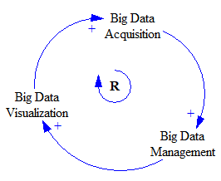
Reinforcing Loop in SD(Contd)
A positive feedback loop (reinforcing) occurs when a change in one variable results in a change in another variable in the same direction. This can lead to amplification and growth in the system.
The reinforcing loop diagram features arrows that signify the direction of the loop, with the positive sign (+) indicating growth in the forward movement.
For example, as more patient data is collected and analyzed, it can lead to better diagnoses, treatment strategies, and patient outcomes. These positive outcomes encourage healthcare providers to invest more in data acquisition, management, and visualization technologies, leading to more data-driven insights and improvements.
The Reinforcement Loop Visualization for Big Data in SD
Systems
Engineering Lab (SEL)

Slide 11
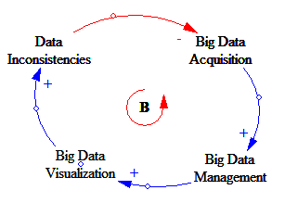
Balancing Loop in SD(Contd)
A negative feedback loop (balancing) occurs when a change in one variable results in a change in another variable in the opposite direction. This typically preserves system stability.
In a balancing loop diagram, arrows indicate the direction of the loop, and a negative sign (-) represents the counteracting or opposing influence, which prevents growth in the opposite direction.
For example, Inconsistent data in healthcare applications creates a significant obstacle, potentially leading to inaccurate diagnoses and unreliable research. This challenge requires rigorous data cleaning, quality assurance, and robust governance. Resolving these issues paves the way for improved data processes, enhancing decision-making and patient outcomes.
The Balancing Loop Visualization for Big Data in SD
Systems
Engineering Lab (SEL)

Slide 12
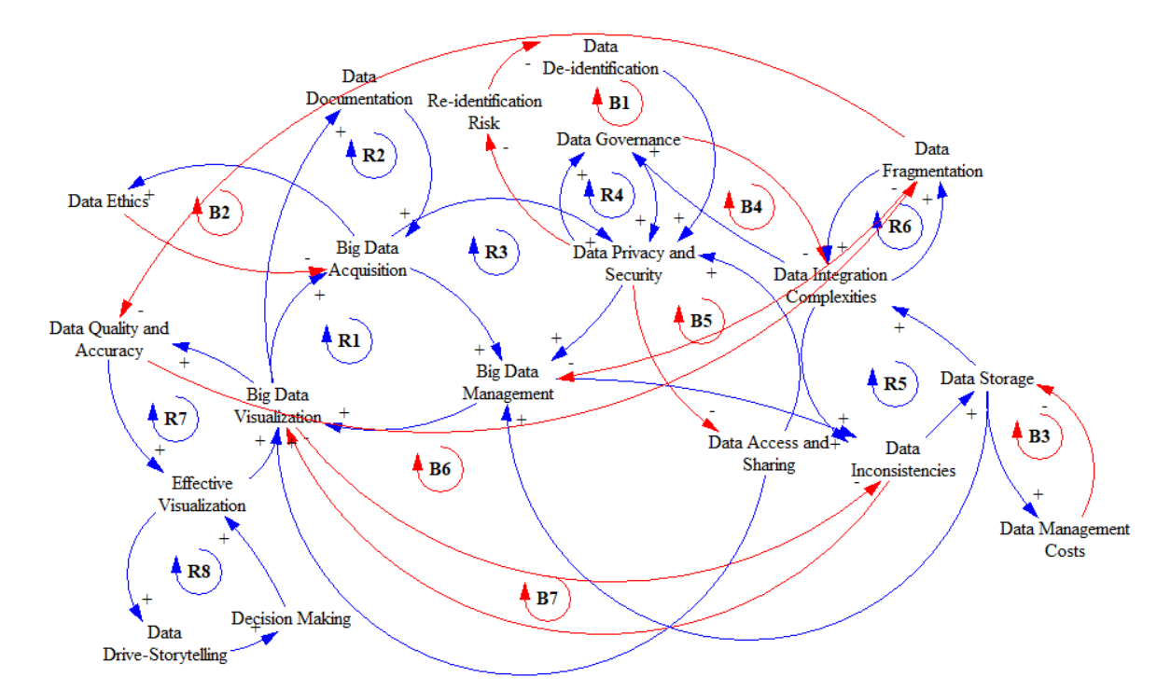
The Risk Factors In Big Data Within The Healthcare
Tobacco control measures
The Visualization of Causal Model for Big Data in Healthcare
Systems Engineering Lab
Notes:
Apparently, The causal loop show the relationship between modifiable and non/modifiable risk factors.
The causal model shows a positive relationship from the age factor the pancreatic cancer factor. Advancing age is a significant risk factor for pancreatic cancer. The risk increases substantially after the of 50, and most cases are diagnosed in individuals over the age of 65.
According to risk estimations, individuals with short-term diabetes face a higher risk of pancreatic cancer than those with long-term diabetes. Two theories suggest reversing causality as the main factor explaining this inverse relationship, particularly for patients with a short duration of diabetes (2 years).
A positive relationship can be seen from the diabetes factor to the pancreatic cancer. Secondly, lifestyle modifications following a diabetes diagnosis or using specific anti-diabetic drugs may have played a role in reducing the risk of pancreatic cancer with prolonged diabetes.
There is a positive relationship from poor diet factor to the pancreatic cancer factor according to the causal model.
Smoking and obesity increase the chance of developing type 2 diabetes mellitus and pancreatic cancer . The relationship from the obesity factor to the pancreatic cancer factor and the smoking factor to the pancreatic cancer is a positive relationship as seen on the loop.

Slide 13
Causal Model Discussions
In healthcare, a reinforcing loop (R1) links big data acquisition, data management, and data visualization. It involves converting physical phenomena into digital health data, ensuring data quality, and presenting insights visually, driving continuous improvement and innovation in healthcare.
In the context of big data in healthcare, the reinforcing loop (R2) connects data collecting, management, visualization, and documentation. This integrated system ensures complete and accurate healthcare data, promoting informed decision-making, quality healthcare practices, and ongoing data-driven improvements.
A reinforcing loop (R3) integrates Big Data Acquisition, Management, Visualization, and Data Privacy and Security in healthcare. In the context of increasing data breaches and privacy concerns, addressing security creates trust, compliance, and responsible data practices, improving data operations while protecting patient information.
A reinforcing loop (R4) connects data privacy, security, and governance. These components safeguard patient data, assure policy consistency, and encourage responsible, secure data use, trust, compliance, and improved healthcare outcomes.
Systems
Engineering Lab (SEL)

Slide 14
Causal Model Discussions
A reinforcing loop (R7) integrates data quality, accuracy, and effective visualization in healthcare big data. High data quality assures reliable insights and effective visualization improves comprehension, resulting in better patient care, diagnosis accuracy, and operational efficiency.
A reinforcing loop (R8) connects Effective Visualization, Data-Driven Storytelling, and Decision Making in healthcare. Effective visualization improves data-driven storytelling, which influences informed decision-making and, as a result, improves patient outcomes and healthcare effectiveness.
The HIPAA Privacy Rule permits patient data de-identification for privacy protection. The balancing loop (B1) shows that de-identification safeguards privacy, strengthened by data privacy and security measures, preventing unauthorized access and re-identification risks and ensuring patient confidentiality in big data healthcare.
The data integration complexity and data fragmentation reinforcing loop(R6) create issues in managing large data in healthcare due to various systems, schema variances, and restricted interconnection. This loop complicates data collecting and management.
Systems
Engineering Lab (SEL)

Slide 15
Applications of Big Data Analytics In Healthcare
Big Data Analytics in Healthcare (BDAH) is a valuable response to healthcare cost concerns. It has the potential to improve illness diagnosis and treatment options. Several applications of BDAH in healthcare are presented, including disease detection and therapy optimization, emphasizing the potential for improving healthcare efficiency and results through data-driven insights.

Slide 16
Conclusion
Integrating big data, EHRs, and HISs holds immense promise for reshaping healthcare.
1
This integration can enhance patient care, foster collaboration among healthcare providers, advance research, and enable effective public health interventions through data analysis.
2
Overcoming data fragmentation challenges requires promoting interoperability
standards and standardization within healthcare systems.
3
4
These risks encompass concerns regarding data privacy and security, data inconsistencies arising from human behaviour, data fragmentation, issues related to data quality, re-identification risks, and complex challenges in data governance.
System Dynamics offers a structured approach to understanding and improving healthcare systems. It emphasizes the dynamic nature of healthcare operations, aiding organizations in managing complexity for better patient care and resource optimization.
Systems
Engineering Lab (SEL)

Slide 17
References
1] ABOUELMEHDI, K., BENI-HSSANE, A., KHALOUFI, H., AND SAADI, M. Big data security and privacy in healthcare: A review. Procedia Computer Science 113 (2017), 73–80.
[2] AGRAWAL, D., BERNSTEIN, P., BERTINO, E., DAVIDSON, S., DAYAL, U., FRANKLIN, M., GEHRKE, J., HAAS, L., HALEVY, A., HAN, J., ET AL. Challenges and opportunities with big data 2011-1.
[3] AL-JARRAH, O. Y., YOO, P. D., MUHAIDAT, S., KARAGIANNIDIS, G. K., AND TAHA, K. Efficient machine learning for big data: A review. Big Data Research 2, 3 (2015), 87–93.
[4] ALEXANDER, C. A., AND WANG, L. Big data analytics in heart attack prediction. J Nurs Care 6, 393 (2017), 2167–1168.
[5] ARCHENAA, J., AND ANITA, E. M. A survey of big data analytics in healthcare and government. Procedia Computer Science 50 (2015), 408–413.
[6] AUFFRAY, C., BALLING, R., BARROSO, I., BENCZE, L., BENSON, M., BERGERON, J., BERNAL-DELGADO, E., BLOMBERG, N., BOCK, C., CONESA, A., ET AL. Making sense of big data in health research: towards an eu action plan. Genome medicine 8, 1 (2016), 1–13
Systems
Engineering Lab (SEL)

Slide 18

Systems
Engineering Lab (SEL)

